Slide 1
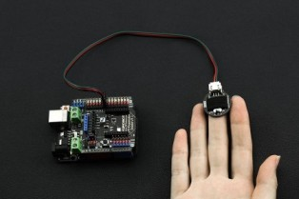
HEART BEAT SENSOR

Slide 2
Presentation by:
Names | Roll Numbers
Ayush Kumar | 18700320003
Md Ayaz Alam | 18700320026
Rahul Pandey | 18700321126
Rishav Kumar | 18700320030
Rishav Raj | 18700320020

Slide 3
Contents
Introduction
Principle of the Heart Beat Sensor
Why are we doing this project
Components of the project
Component Cost
Components Explanation
Block Diagram
Circuit Structure
Circuit Design
Working of the circuit
Software Required
Challenges Faced
Programming Code
Outcome
After completion circuit view in Software
After completion circuit view in Hardware
Conclusion
Enhancement

Slide 4
Introduction
Monitoring heart rate is very important for athletes, patients as it determines the condition of the heart (just heart rate). There are many ways to measure heart rate and the most precise one is using an Electrocardiography.
But the more easy way to monitor the heart rate is to use a Heartbeat Sensor. It comes in different shapes and sizes and allows an instant way to measure the heartbeat.
Heartbeat Sensors are available in Wrist Watches (Smart Watches), Smart Phones, chest straps, etc. The heartbeat is measured in beats per minute or bpm, which indicates the number of times the heart is contracting or expanding in a minute.

Slide 5
Principle of Heartbeat Sensor
The working principle of heart beat sensor is based on photoplethysmogram.
This principle states that , the change in the volume of blood in an organ is measured by the change in the intensity of light passing through that organ.
to the heart beat sensor the source of light is usually IR LED and the detector is generally a photo diode

Slide 6
OBJEctive of this project:
This is something which is related to electronics so we are doing this project to get confidence and to gain practical knowledge about some components and devices .
This project can be handy to the people who are unable to afford expensive devices , if it is mass produced.
This project will also enhance our teamwork skills.

Slide 7
Components:
Hardware:
Arduino UNO
16 x 2 LCD Display
10KΩ Potentiometer
330Ω Resistor (Optional – for LCD backlight)
Push Button
Heartbeat Sensor Module with Probe (finger based)
Mini Breadboard
Connecting Wires
Software:
Arduino UNO
Wires
Heartbeat Sensor
Heartbeat input
Potentiometer-HG
Switch
Digital Oscilloscope
DC Voltmeter
Virtual Terminal

Slide 8
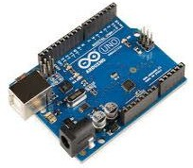
Components:
1.Arduino Uno
Arduino Uno is a microcontroller board based on the ATmega328P (datasheet). It has 14 digital input/output pins (of which 6 can be used as PWM outputs), 6 analog inputs, a 16 MHz quartz crystal, a USB connection, a power jack, an ICSP header and a reset button.

Slide 9
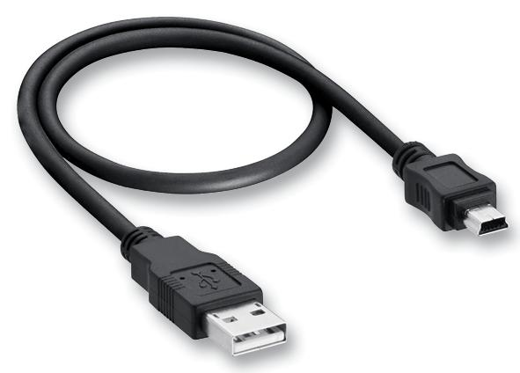
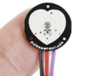
2. USB Cable
3. Pulse sensor Arduino
Well-designed plug-and-play heart-rate sensor for Arduino.
The pulse sensor module has a light
helps in measuring the pulse rate.
Red-VCC
Purple- OUT
Black- GRD
Universal Serial Bus establishes specifications for cables and connectors used for connection, communication and power supply between computers, peripherals and other computers.

Slide 10
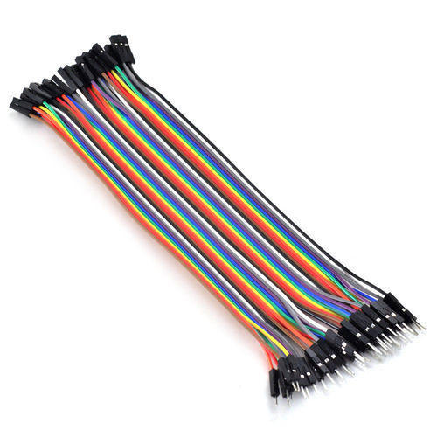
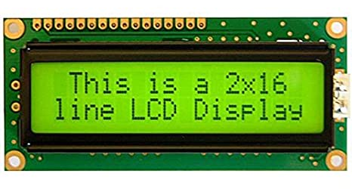
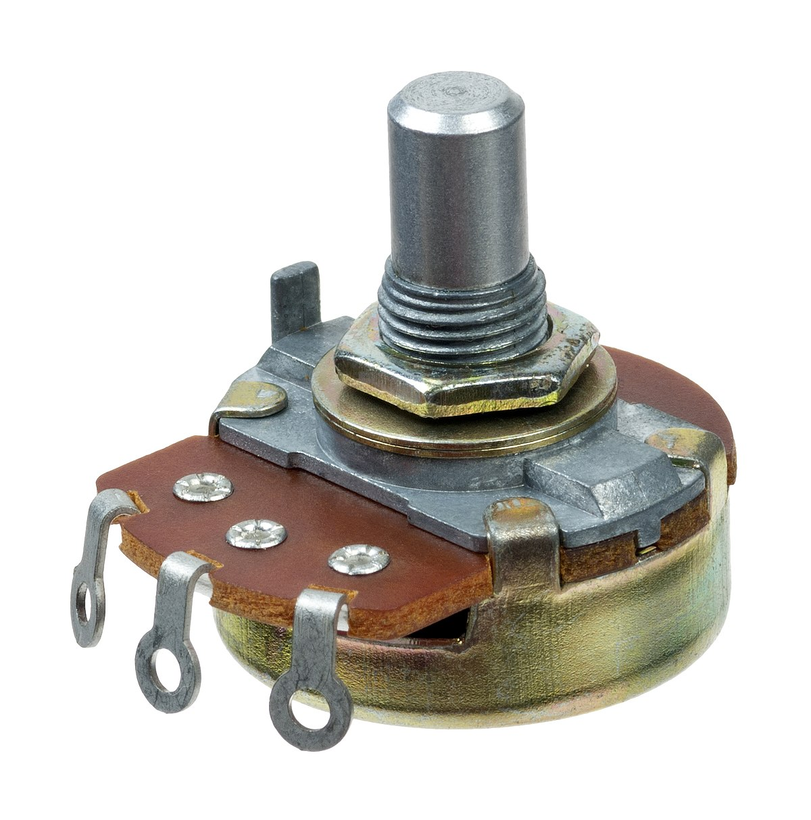
4.Jumper wire
A jump wire is an electrical wire, or group of cables, with a connector or pin at each end, which is normally used to interconnect the components of a breadboard
5. LCD
The LCD (Liquid Crystal Display) is a type of display that uses the liquid crystals for its operation. The library that allows us to control the LCD display is called Liquid Crystal
6. Potentiometer
A potentiometer is a variable resistor from one side to the wiper.

Slide 11
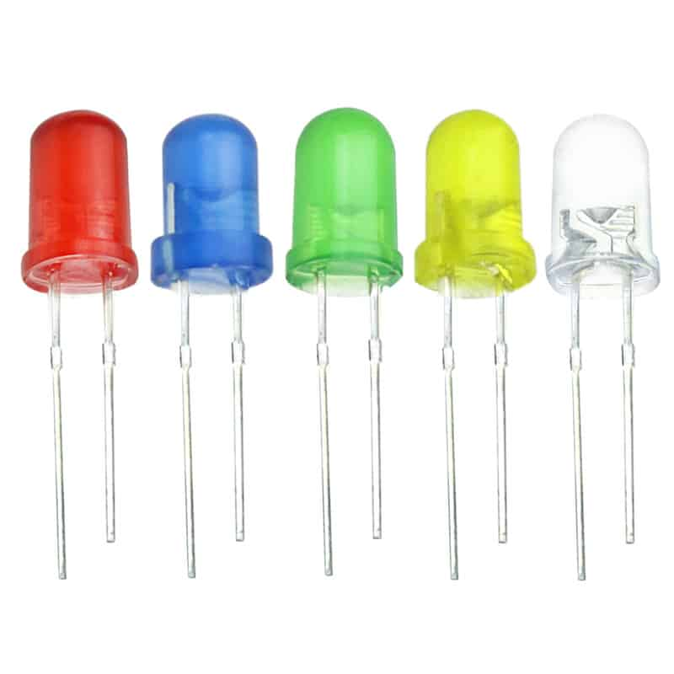
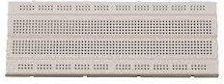
5. LED
6. Breadboard
A breadboard is a rectangular board with many
mounting holes.They are used for creating
electrical connections between electronic
components.
A light-emitting diode (LED) is a semiconductor light source that emits light when current flows through it

Slide 12
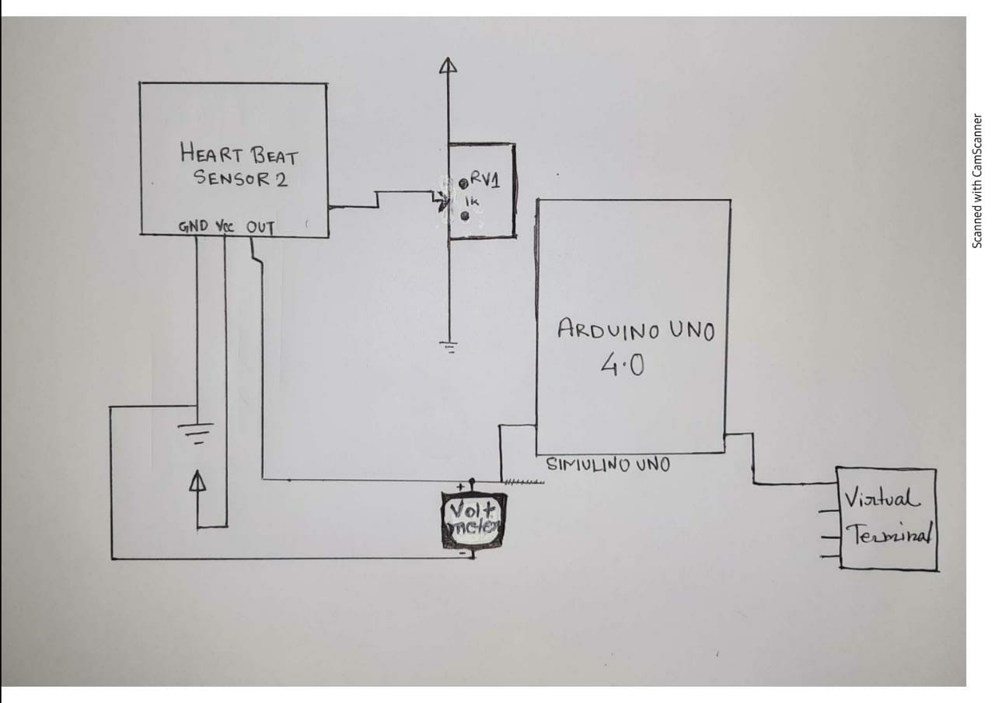
Block diagram of circuit

Slide 13
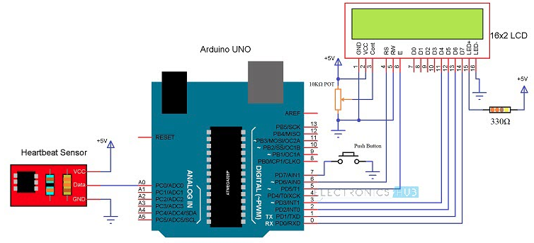
Circuit structure of Heartbeat Sensor

Slide 14
Circuit Design
The circuit design of Arduino based Heart rate monitor system using Heart beat Sensor is very simple. First, in order to display the heartbeat readings in bpm, we have to connect a 16×2 LCD Display to the Arduino UNO.
The 4 data pins of the LCD Module (D4, D5, D6 and D7) are connected to Pins 1, 1, 1 and 1 of the Arduino UNO. Also, a 10KΩ Potentiometer is connected to Pin 3 of LCD (contrast adjust pin). The RS and E (Pins 3 and 5) of the LCD are connected to Pins 1 and 1 of the Arduino UNO.
Next, the output of the Heartbeat Sensor Module is connected to the digital Output Pin of Arduino.

Slide 15
Working of the circuit:
Upload the code to Arduino UNO and Power on the system. The Arduino asks us to place our finger in the sensor and press the switch.
Place any finger (except the Thumb) in the sensor clip and push the switch (button). Based on the data from the sensor, Arduino calculates the heart rate and displays the heartbeat in bpm.
While the sensor is collecting the data, sit down and relax and do not shake the wire as it might result in a faulty values.
After the result is displayed on the LCD, if you want to perform another test, just push the rest button on the Arduino and start the procedure once again.

Slide 16
Challenges
Heartbeat Sensor , Heartbeat input & Arduino Uno is not present in Proteus8 library.
A different set of library has to be installed from google.

Slide 17
Code:
#define USE_ARDUINO_INTERRUPTS true #include <PulseSensorPlayground.h> // Includes the PulseSensorPlayground Library.
// Variables
const int PulseWire = 0; // PulseSensor PURPLE WIRE connected to ANALOG PIN 0
const int LED13 = 13; // The on-board Arduino LED, close to PIN 13.
int Threshold = 550; // Determine which Signal to "count as a beat" and which to ignore.
// Use the "Getting Started Project" to fine-tune Threshold Value beyond default setting.
//Otherwise leave the default "550" value.
PulseSensorPlayground pulseSensor; // Creates an instance of the PulseSensorPlayground object called "pulseSensor”
void setup() {
Serial.begin(9600); // For Serial Monitor
// Configure the PulseSensor object, by assigning our variables to it.
pulseSensor.analogInput(PulseWire);
pulseSensor.blinkOnPulse(LED13); //auto-magically blink Arduino's LED with heartbeat.
pulseSensor.setThreshold(Threshold);

Slide 18
// Double-check the "pulseSensor" object was created and "began" seeing a signal.
if (pulseSensor.begin()) {
Serial.println("We created a pulseSensor Object !"); //This prints one time at Arduino power-up, or on
Arduino reset.
}
}
void loop() {
int myBPM = pulseSensor.getBeatsPerMinute(); // Calls function on our pulseSensor object that returns
BPM as an "int".
// "myBPM" hold this BPM value now.
if (pulseSensor.sawStartOfBeat()) { // Constantly test to see if "a beat happened".
Serial.println("♥ A HeartBeat Happened ! "); // If test is "true", print a message "a heartbeat happened".
Serial.print("BPM: "); // Print phrase "BPM: "
Serial.println(myBPM); // Print the value inside of myBPM.
}
delay(20); // considered best practice in a simple sketch.}
}

Slide 19
Outcome:
A normal resting heart rate is between 60 to 100 beats per minute, but it can vary from person to person.
Children- 6 to 15 (70 to 100) beat per min
Adult – 18 to over (60 to 100) beat per min

Slide 20
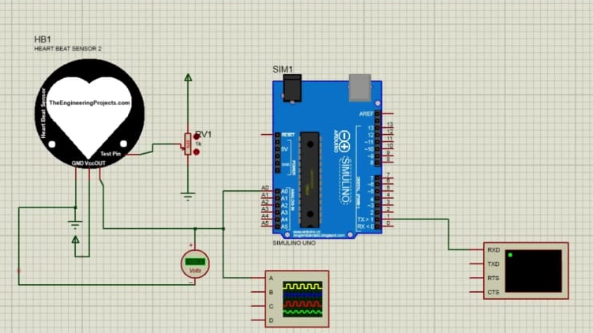
circuit structure-in software

Slide 21
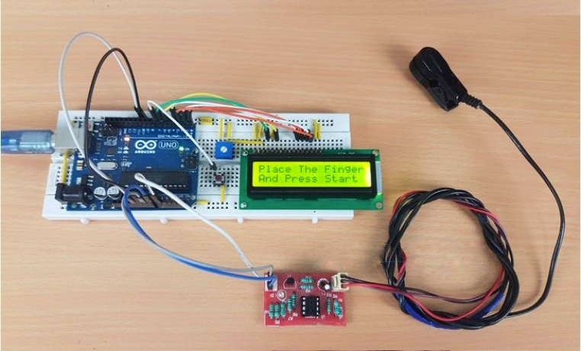
circuit structure-in hardware

Slide 22
Conclusion:
A simple project involving Arduino UNO, 16×2 LCD and Heartbeat Sensor Module is designed here which can calculate the heart rate of a person.
This project can be used as an inexpensive alternative to Smart Watches and other expensive Heart Rate Monitors.

Slide 23
Enhancement:
The accuracy should be increased.
It should be made more cheaper . i.e it should be made at a affordable rate to ensure quality of health.
Performance should be enhanced.

Slide 24
Thank You

